Slide 1
Employee Data Analysis using Excel
STUDENT NAME: KAMALEESWARI MUNUSAMY
REGISTER NO: 122204446
NM ID: EC00D2C3F4DB8A1903C4538DA1CAF7D6
DEPARTMENT: B.COM(CS)
COLLEGE: AVICHI COLLEGE OF ARTS AND SCIENCE

Slide 2
PROJECT TITLE
Employee Dataset Analysis using Power Query, Charts and Graphs Excel

Slide 3


AGENDA
Problem Statement
Project Overview
End Users
Our Solution and Proposition
Dataset Description
Modelling Approach
Results and Discussion
Conclusion
3/21/2024 Annual Review

Slide 4

PROBLEM STATEMENT "The company's sales data is scattered across multiple worksheets and workbooks, making it difficult to analyze and report on sales trends. The data requires cleaning, transformation, and consolidation to provide accurate insights. Using Power Query, create a solution that automates the data import, cleaning, and reporting process, enabling efficient analysis and informed decision-making."

Slide 5

PROJECT OVERVIEW "This project aims to create a dynamic employee data management system using Power Query in Excel. The system will automate the import, cleaning, and consolidation of employee data from various sources, enabling real-time insights and reporting. The project will deliver a centralized dashboard for tracking employee information, performance metrics, and workforce analytics. The solution will enhance data accuracy, reduce manual effort, and support informed HR decision-making."
.

Slide 6

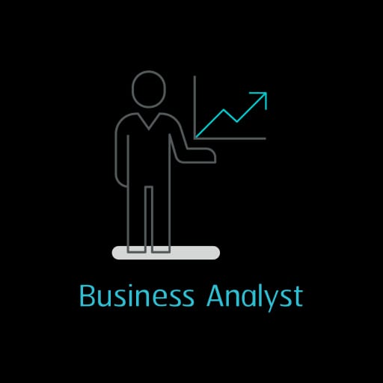


WHO ARE THE END USERS? Employees Business Analysts Managers

Slide 7

OUR SOLUTION AND ITS VALUE PROPOSITION Power Query Formula-To know the employee performance level Filtering -To remove the missing values Graph – Data Visualisation

Slide 8
Dataset Description Employee Dataset has been taken from Kaggle. There were 26 Features. Employee ID was in Numerical. Employee Type was differentiated. Performance Level was taken. Gender was categorised into Male and Female.

Slide 9
MODELLING
Data Collection: We collected the data from the Kaggle website and we used it for the project purpose.
Feature Collection: We used the some of the 9 features in the project such as performance level, pivot table, formula etc.
Data Cleaning: We used the two ways of cleaning the data by finding out the missing values and also by filtering the employee data.
Graphs: Graphs gave the visualisation of Data.
9

Slide 10
RESULTS
10

Slide 11
RESULTS
11

Slide 12
CONCLUSION “The Power Query project has successfully automated the employee data management process, providing a centralized and standardized dataset. The solution has improved data accuracy, reduced manual effort, and enhanced decision-making capabilities. With real-time insights and user-friendly dashboards, HR managers and stakeholders can now efficiently track employee information and performance metrics. The project has demonstrated the power of Power Query in transforming complex data management tasks into streamlined and efficient processes. The solution is scalable and adaptable for future growth and changing business needs."

